Slide 1
Notes:
‹#›

Slide 2
Variations on a Theme
Offspring resemble their parents more than they do unrelated individuals
Heredity (遺傳) is the transmission of traits from one generation to the next
Variation(變異)is demonstrated by the differences in appearance that offspring show from parents and siblings
Genetics is the scientific study of heredity and variation

Slide 3

Figure 13.1
What accounts for family resemblance?
Notes:
Figure 13.1 What accounts for family resemblance?

Slide 4
Concept 13.1: Offspring acquire genes from parents by inheriting chromosomes
In a literal sense, children do not inherit particular physical traits from their parents
It is genes that are actually inherited

Slide 5
Inheritance of Genes
Genes are the units of heredity and are made up of segments of DNA
Genes are passed to the next generation via reproductive cells called gametes配子 (sperm and eggs)
Most DNA is packaged into chromosomes
Humans have 46 chromosomes in the nuclei of their somatic cells (體細胞), all cells of the body except gametes and their precursors
A gene’s specific position along a chromosome is called its locus基因座，染色體上的固定位置

Slide 6
Comparison of Asexual and Sexual Reproduction
In asexual reproduction, a single individual passes all of its genes to its offspring without the fusion of gametes
A clone is a group of genetically identical individuals from the same parent
In sexual reproduction, two parents give rise to offspring that have unique combinations of genes inherited from the two parents

Slide 7
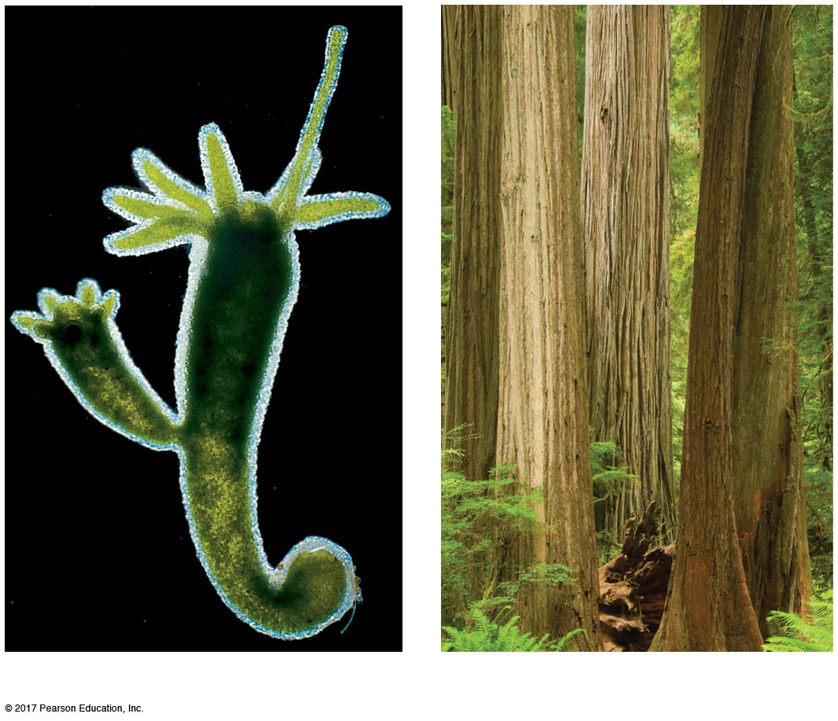
Figure 13.2
Asexual reproduction in two multicellular organisms
0.5 mm
Parent
Bud
(a) Hydra
(b) Redwoods
Notes:
Figure 13.2 Asexual reproduction in two multicellular organisms

Slide 8
Concept 13.2: Fertilization and meiosis alternate in sexual life cycles
A life cycle is the generation-to-generation sequence of stages in the reproductive history of an organism

Slide 9
Sets of Chromosomes in Human Cells
Human somatic cells have 23 pairs of chromosomes
A karyotype (核型)is an ordered display of the pairs of chromosomes from a cell
The two chromosomes in each pair are called homologous chromosomes, or homologs (同源基因)
Chromosomes in a homologous pair are the same length and shape and carry genes controlling the same inherited characters

Slide 10
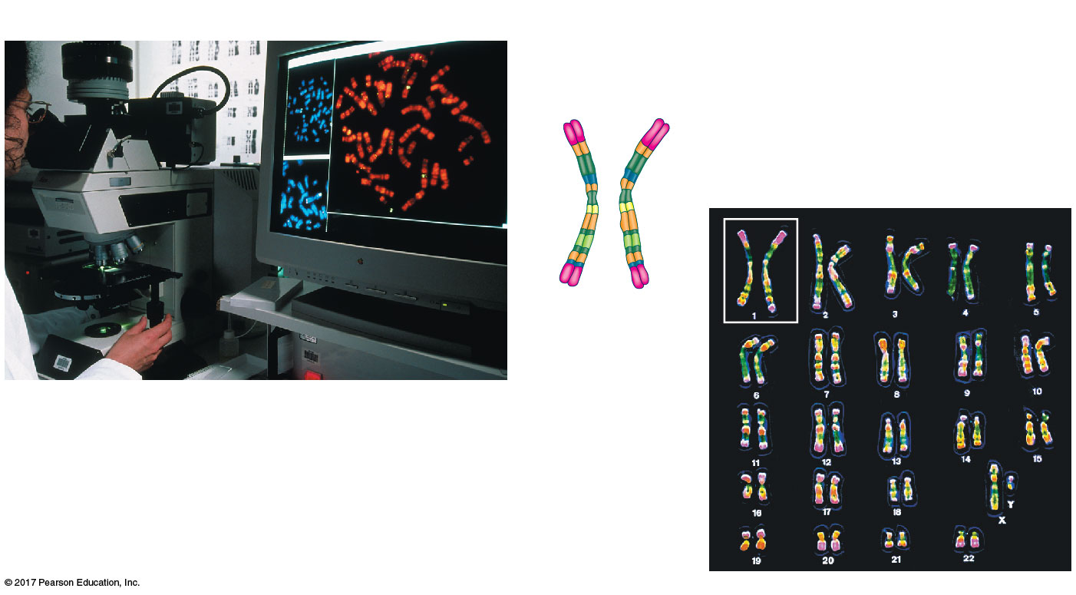
Figure 13.3
Research method: preparing a karyotype
Application
Technique
Pair of homologous
duplicated chromosomes
Centromeres
5 µm
Sister
chromatids
Metaphase
chromosome
Notes:
Figure 13.3 Research method: preparing a karyotype

Slide 11
The sex chromosomes, which determine the sex of the individual, are called X and Y
Human females have a homologous pair of X chromosomes (XX)
Human males have one X and one Y chromosome
The remaining 22 pairs of chromosomes are called autosomes (體染色體)

Slide 12
Each pair of homologous chromosomes includes one chromosome from each parent
The 46 chromosomes in a human somatic cell are two sets of 23: one from the mother and one from the father
A diploid cell二倍體細胞(2n) has two sets of chromosomes
For humans, the diploid number is 46 (2n = 46)

Slide 13
In a cell in which DNA synthesis has occurred, each chromosome is replicated
Each replicated chromosome consists of two identical sister chromatids (染色單體)

Slide 14
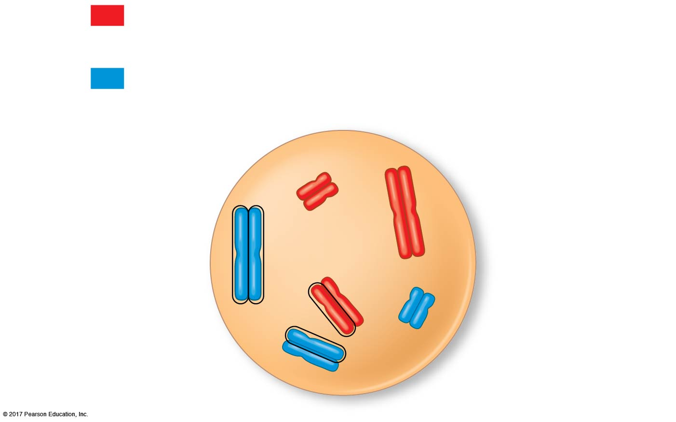
Figure 13.4
Describing chromosomes
Maternal set of chromosomes (n = 3)
2n = 6
Paternal set of chromosomes (n = 3)
Sister chromatids
of one duplicated
chromosome
Centromere
Two nonsister
chromatids in
a homologous pair
Pair of homologous
chromosomes
(one from each set)
Notes:
Figure 13.4 Describing chromosomes

Slide 15
A gamete (sperm or egg) contains a single set of chromosomes and is thus a haploid cell單倍體細胞(n)
For humans, the haploid number is 23 (n = 23)
Each set of 23 consists of 22 autosomes and a single sex chromosome
In an unfertilized egg (ovum卵子), the sex chromosome is X
In a sperm cell, the sex chromosome may be either X or Y

Slide 16
Behavior of Chromosome Sets in the Human Life Cycle
Fertilization is the union of gametes (the sperm and the egg)
The fertilized egg is called a zygote合子and has one set of chromosomes from each parent
The zygote produces somatic cells by mitosis and develops into an adult

Slide 17
At sexual maturity, the ovaries and testes睾丸produce haploid gametes
Gametes are the only types of human cells produced by meiosis, rather than mitosis
Meiosis results in one set of chromosomes in each gamete
Fertilization and meiosis alternate in sexual life cycles to maintain chromosome number

Slide 18
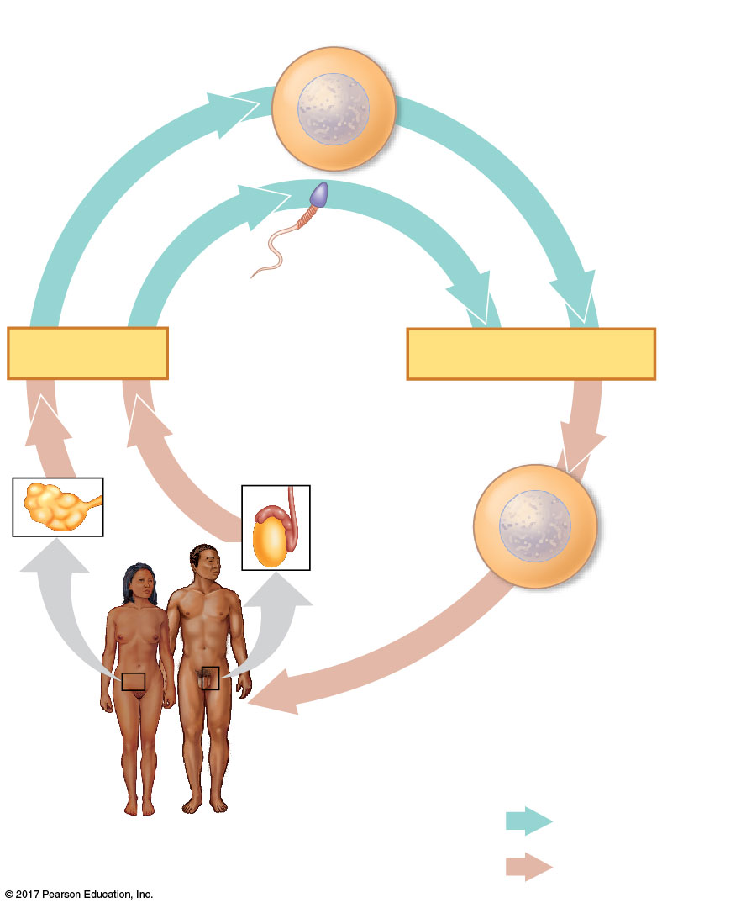
Figure 13.5
Haploid gametes (n = 23)
The human life cycle
Egg (n)
Sperm (n)
MEIOSIS
FERTILIZATION
Testis
Ovary
Diploid
zygote
(2n = 46)
Mitosis and
development
Multicellular diploid
adults (2n = 46)
Haploid (n)
Diploid (2n)
Notes:
Figure 13.5 The human life cycle

Slide 19
The Variety of Sexual Life Cycles
The alternation of meiosis and fertilization is common to all organisms that reproduce sexually
The three main types of sexual life cycles differ in the timing of meiosis and fertilization

Slide 20
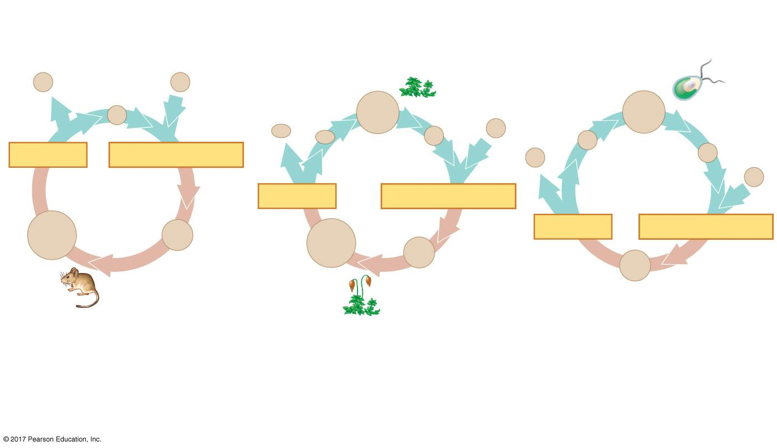

Figure 13.6
Three types of sexual life cycles
Haploid (n)
Haploid multi-
cellular organism
(gametophyte)
Diploid (2n)
Haploid unicellular or
multicellular organism
n
Gametes
n
n
Mitosis
n
Mitosis
Mitosis
n
Mitosis
n
n
n
n
n
MEIOSIS
FERTILIZATION
Spores
n
n
Gametes
Gametes
n
MEIOSIS
FERTILIZATION
2n
Zygote
2n
MEIOSIS
FERTILIZATION
2n
2n
Zygote
2n
Mitosis
Mitosis
Zygote
Diploid
multicellular
organism
Diploid
multicellular
organism
(sporophyte)
(a) Animals
(b) Plants and some algae
(c) Most fungi and some protists
Notes:
Figure 13.6 Three types of sexual life cycles

Slide 21
Gametes are the only haploid cells in animals
They are produced by meiosis and undergo no further cell division before fertilization
Gametes fuse to form a diploid zygote that divides by mitosis to develop into a multicellular organism

Slide 22
Plants and some algae exhibit an alternation of generations
This life cycle includes both a diploid and haploid multicellular stage
The diploid organism, called the sporophyte孢子體, makes haploid spores孢子by meiosis

Slide 23
Each spore grows by mitosis into a haploid organism called a gametophyte配子體
A gametophyte makes haploid gametes by mitosis
Fertilization of gametes results in a diploid sporophyte

Slide 24
In most fungi and some protists, the only diploid stage is the single-celled zygote; there is no multicellular diploid stage
The zygote produces haploid cells by meiosis
Each haploid cell grows by mitosis into a haploid multicellular organism
The haploid adult produces gametes by mitosis

Slide 25
Depending on the type of life cycle, either haploid or diploid cells can divide by mitosis
However, only diploid cells can undergo meiosis
In all three life cycles, the halving and doubling of chromosomes contributes to genetic variation in offspring

Slide 26
Concept 13.3: Meiosis reduces the number of chromosome sets from diploid to haploid
Like mitosis, meiosis is preceded by the replication of chromosomes
Meiosis takes place in two consecutive cell divisions, called meiosis I and meiosis II
The two cell divisions result in four daughter cells, rather than the two daughter cells in mitosis
Each daughter cell has only half as many chromosomes as the parent cell

Slide 27
The Stages of Meiosis
Chromosomes duplicate before meiosis
The resulting sister chromatids are closely associated along their lengths
This is called sister chromatid cohesion
The chromatids are sorted into four haploid daughter cells

Slide 28
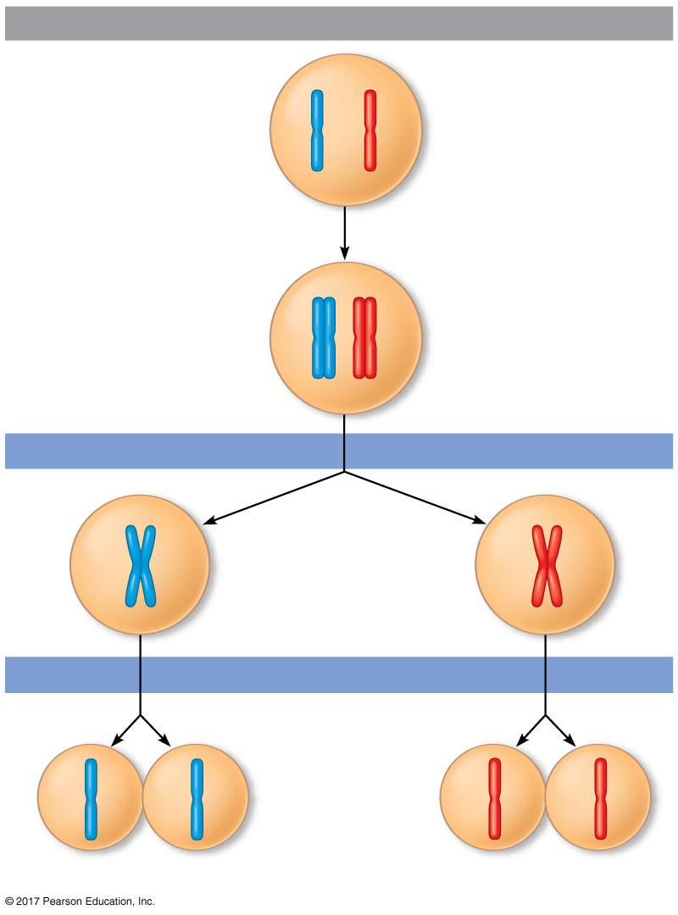
Figure 13.7
Interphase
Pair of
homologous
chromosomes
in diploid
parent cell
How meiosis reduces chromosome number?
Pair of duplicated
homologous
chromosomes
Chromosomes
duplicate
Sister
chromatids
Diploid cell with
duplicated
chromosomes
Meiosis I
1
Homologous
chromosomes
separate
Haploid cells with
duplicated chromosomes
Meiosis II
2
Sister chromatids
separate
Haploid cells with unduplicated chromosomes
Notes:
Figure 13.7 Overview of meiosis: how meiosis reduces chromosome number

Slide 29
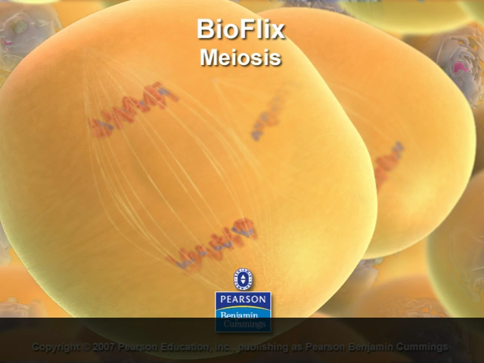
BioFlix: Meiosis

Slide 30
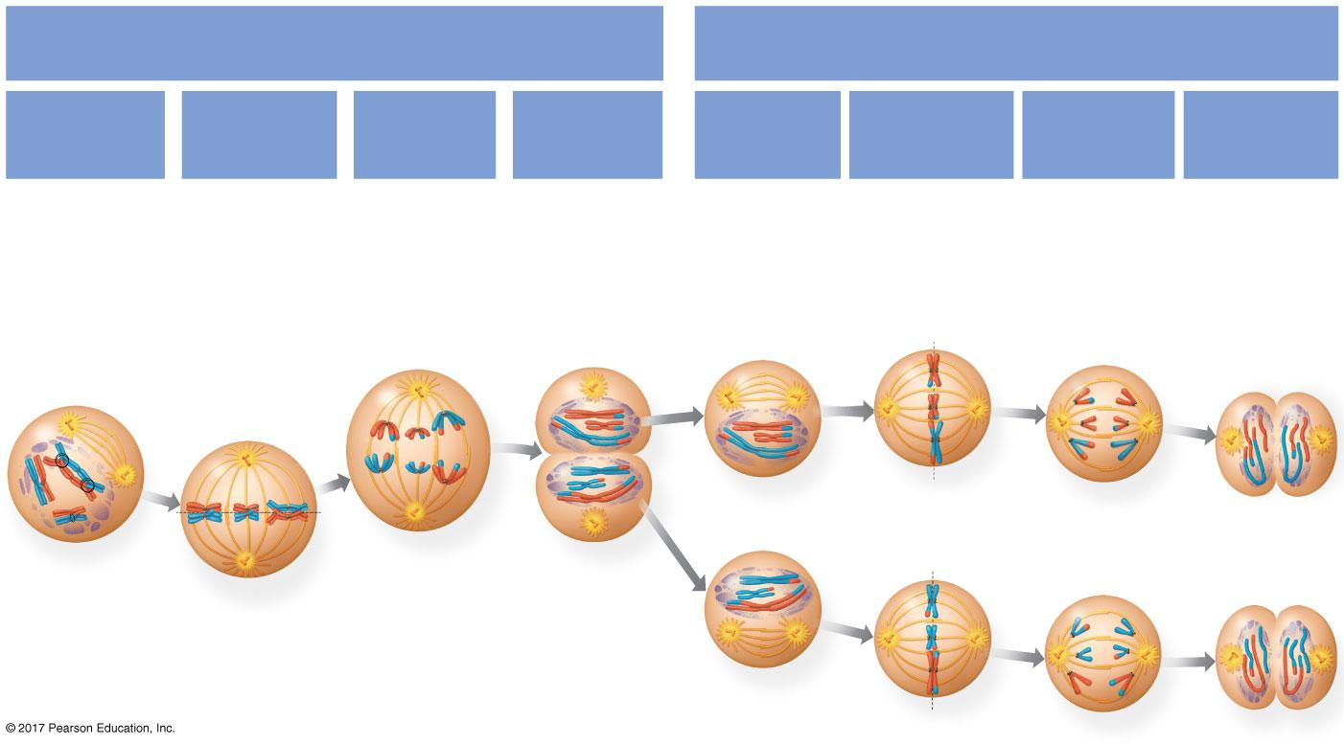
Figure 13.8
MEIOSIS I: Separates
homologous chromosomes
MEIOSIS II: Separates
sister chromatids
Telophase I
and
Cytokinesis
Telophase II
and
Cytokinesis
Prophase I
Metaphase I
Anaphase I
Prophase II
Metaphase II
Anaphase II
Centrosome
(with
centriole
pair)
Kineto-
chore
(at centro-
mere)
Sister
chromatids
remain
attached
Sister
chroma-
tids
Chiasmata
Kineto-
chore
micro-
tubules
Spindle
micro-
tubules
Sister
chromatids
separate
Haploid
daughter
cells
forming
Pair of
homo-
logous
chromo-
somes
Homologous
chromosomes
separate
Cleavage
furrow
Fragments
of nuclear
envelope
Meta-
phase
plate
Centromere
Notes:
Figure 13.8 Exploring meiosis in an animal cell

Slide 31
Division in meiosis I occurs in four phases:
prophase I
metaphase I
anaphase I
telophase I and cytokinesis

Slide 32
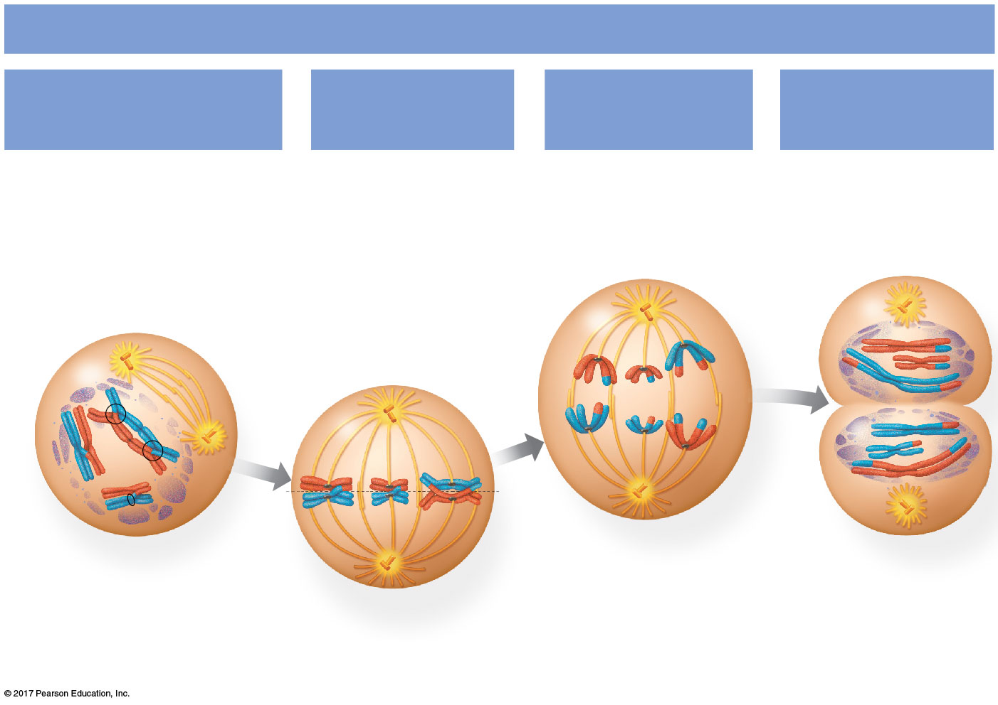
Figure 13.8a
MEIOSIS I: Separates homologous chromosomes
Prophase I
Metaphase I
Anaphase I
Telophase I
and Cytokinesis
Centrosome
(with
centriole
pair)
Sister
chromatids
remain
attached
Kinetochore
(at centromere)
Sister
chroma-
tids
Chiasmata
Spindle
micro-
tubules
Kinetochore
microtubules
Cleavage
furrow
Homologous
chromosomes
separate
Pair of
homo-
logous
chromo-
somes
Fragments
of nuclear
envelope
Metaphase
plate
Centromere
Notes:
Figure 13.8a Exploring meiosis in an animal cell (part 1: meiosis I)

Slide 33
Prophase I
In early prophase I, each chromosome pairs with its homolog and crossing over染色體互換occurs
X-shaped regions called chiasmata染色體交叉are sites of crossovers

Slide 34
Metaphase I
In metaphase I, pairs of homologs line up at the metaphase plate, with one chromosome facing each pole
Microtubules from one pole are attached to the kinetochore of one chromosome of each pair
Microtubules from the other pole are attached to the kinetochore of the other chromosome

Slide 35
Anaphase I
In anaphase I, pairs of homologous chromosomes separate
One chromosome of each pair moves toward opposite poles, guided by the spindle apparatus
Sister chromatids remain attached at the centromere and move as one unit toward the pole

Slide 36
Telophase I and Cytokinesis
In the beginning of telophase I, each half of the cell has a haploid set of chromosomes; each chromosome still consists of two sister chromatids
Cytokinesis usually occurs simultaneously, forming two haploid daughter cells

Slide 37
In animal cells, a cleavage furrow forms; in plant cells, a cell plate forms
No chromosome replication occurs between the end of meiosis I and the beginning of meiosis II because the chromosomes are already replicated

Slide 38
Division in meiosis II also occurs in four phases:
prophase II
metaphase II
anaphase II
telophase II and cytokinesis
Meiosis II is very similar to mitosis

Slide 39
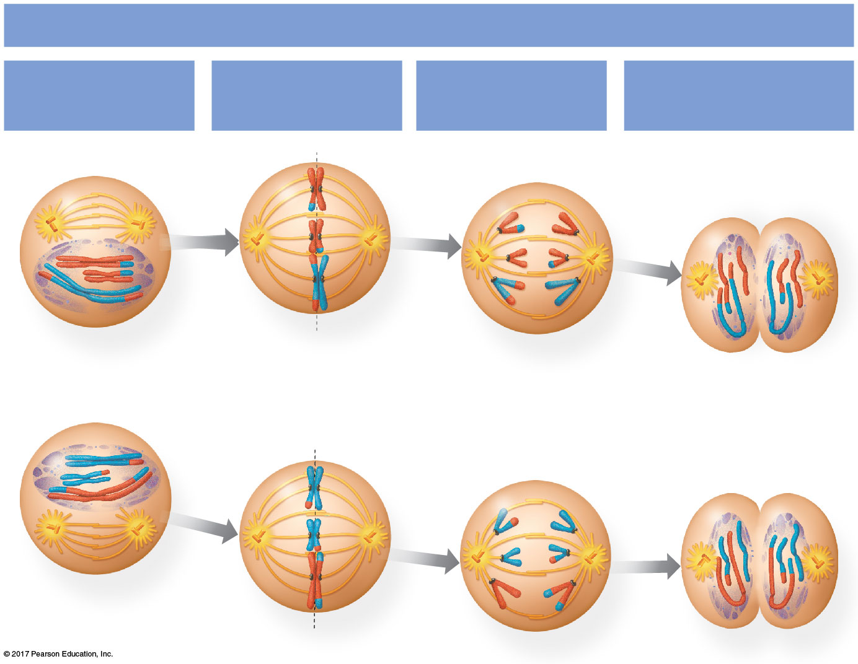
Figure 13.8b
MEIOSIS II: Separates sister chromatids
Prophase II
Metaphase II
Anaphase II
Telophase II
and Cytokinesis
Sister chromatids
separate
Haploid daughter
cells forming
Notes:
Figure 13.8b Exploring meiosis in an animal cell (part 2: meiosis II)

Slide 40
Prophase II
In prophase II, a spindle apparatus forms
In late prophase II, chromosomes (each still composed of two chromatids) move toward the metaphase plate

Slide 41
Metaphase II
In metaphase II, the sister chromatids are arranged at the metaphase plate
Because of crossing over in meiosis I, the two sister chromatids of each chromosome are no longer genetically identical
The kinetochores of sister chromatids attach to microtubules extending from opposite poles

Slide 42
Anaphase II
In anaphase II, the sister chromatids separate
The sister chromatids of each chromosome now move as two newly individual chromosomes toward opposite poles

Slide 43
Telophase II and Cytokinesis
In telophase II, the chromosomes arrive at opposite poles
Nuclei form, and the chromosomes begin decondensing

Slide 44
Cytokinesis separates the cytoplasm
At the end of meiosis, there are four daughter cells, each with a haploid set of unreplicated chromosomes
Each daughter cell is genetically distinct from the others and from the parent cell

Slide 45
Crossing Over and Synapsis(聯會) During Prophase I
After interphase, the sister chromatids are held together by proteins called cohesins
The nonsister chromatids are broken at precisely corresponding positions
A zipper-like structure called the synaptonemal complex聯會複合體 holds the homologs同源基因together tightly
During synapsis, DNA breaks are repaired, joining DNA from one nonsister chromatid to the corresponding segment of another

Slide 46
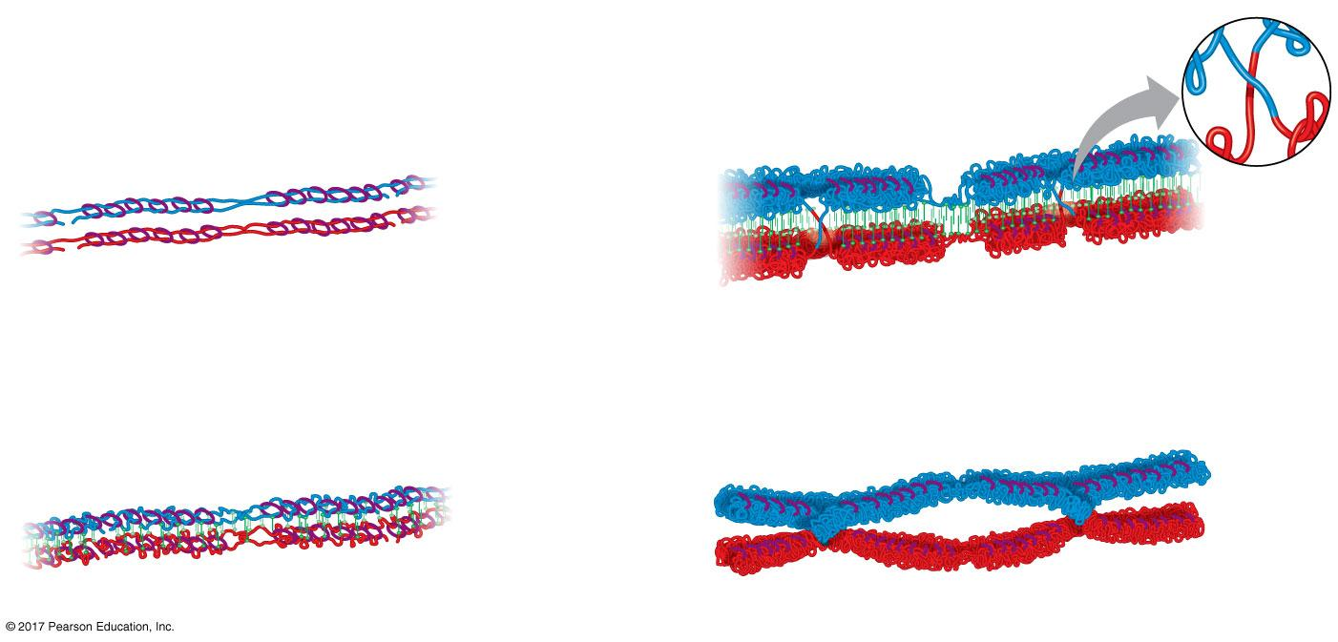
Figure 13.9
Crossing over and synapsis in prophase I: a closer look
Pair of homologous
chromosomes:
Sister
chromatids
Synaptonemal
complex
DNA
breaks
Centromere
DNA
breaks
Paternal
sister
chromatids
Sister
chromatids
Cohesins
Maternal
sister
chromatids
1
3
Crossovers
Synaptonemal
complex forming
Chiasmata
2
4
Notes:
Figure 13.9 Crossing over and synapsis in prophase I: a closer look

Slide 47
A Comparison of Mitosis and Meiosis
Mitosis conserves the number of chromosome sets, producing cells that are genetically identical to the parent cell
Meiosis reduces the number of chromosomes sets from two (diploid) to one (haploid), producing cells that differ genetically from each other and from the parent cell

Slide 48
Three events are unique to meiosis, and all three occur in meiosis I
Synapsis and crossing over in prophase I: Homologous chromosomes physically connect and exchange genetic information
Homologous pairs at the metaphase plate
Separation of homologs during anaphase I

Slide 49
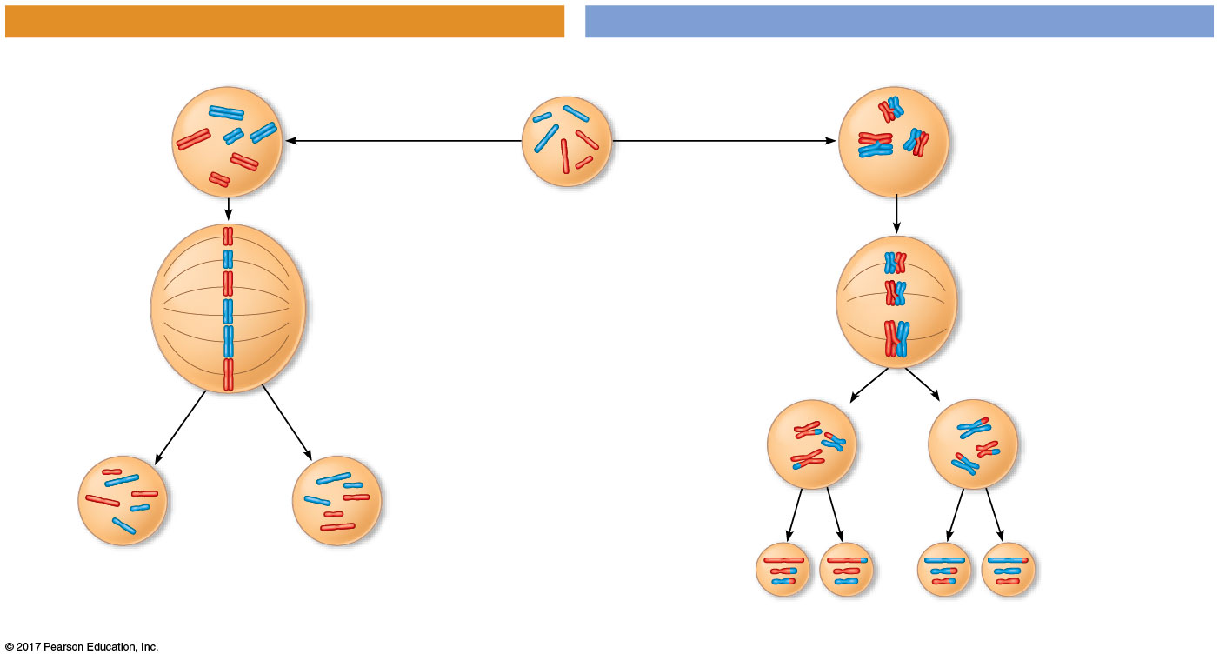
Figure 13.10a
A comparison of mitosis and meiosis
MITOSIS
MEIOSIS
Parent cell
Chiasma
MEIOSIS I
Prophase
Prophase I
Chromosome
duplication
Chromosome
duplication
Pair of
duplicated
homologs
Duplicated
chromosome
2n = 6
Individual
chromosomes
line up.
Pairs of
homologous
chromosomes
line up.
Metaphase
Metaphase I
Anaphase
Sister chromatids
separate.
Anaphase I
Telophase
Homologs
separate.
Telophase I
Sister
chromatids
separate.
Daughter
cells of
meiosis I
MEIOSIS II
2n
2n
Daughter cells
of mitosis
n
n
n
n
Daughter cells of meiosis II
Notes:
Figure 13.10a A comparison of mitosis and meiosis (part 1: mitosis vs. meiosis art)

Slide 50
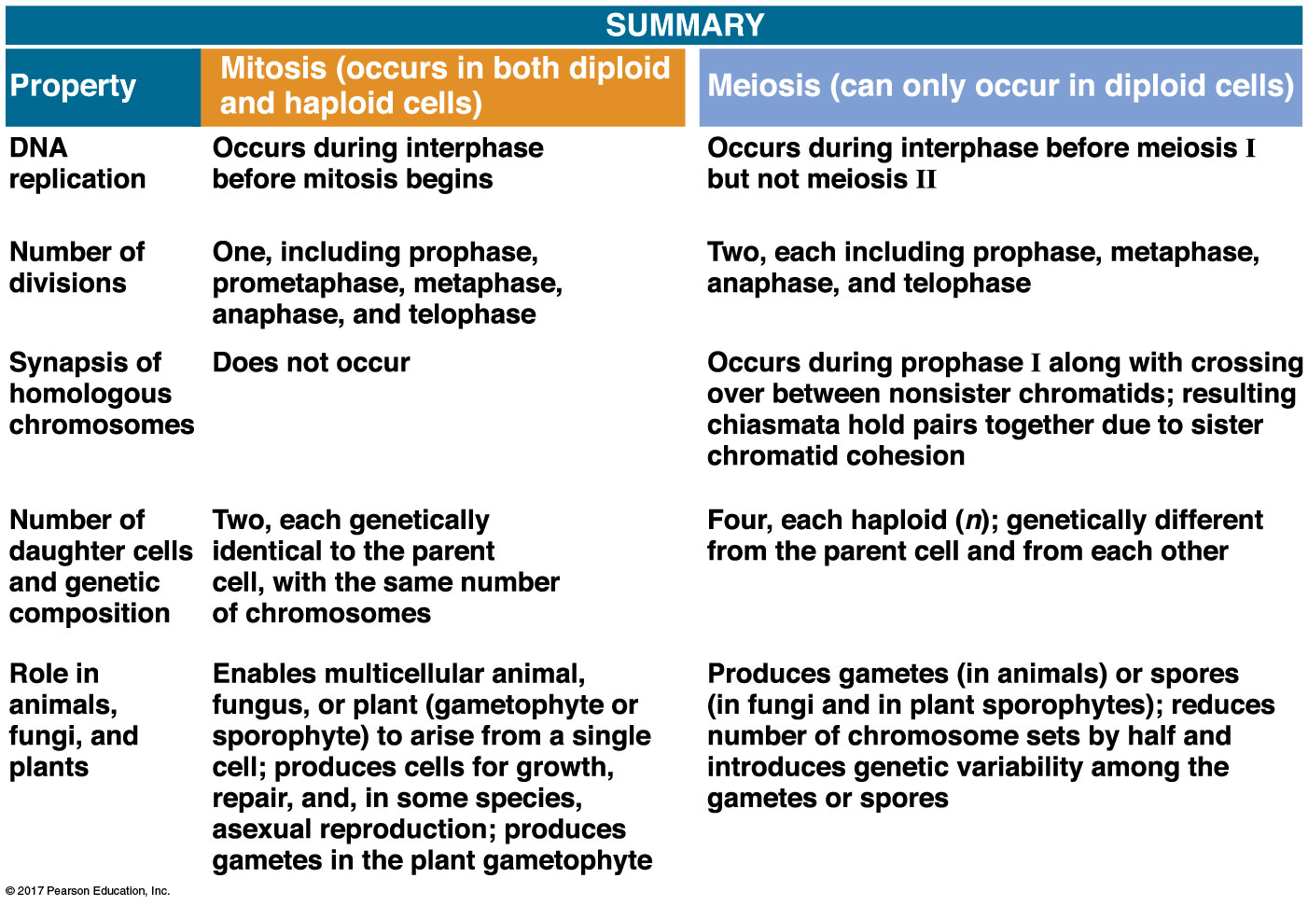
Figure 13.10b
Notes:
Figure 13.10b A comparison of mitosis and meiosis (part 2: mitosis vs. meiosis table)

Slide 51
Sister chromatid cohesion allows sister chromatids to stay together through meiosis I
In mitosis, cohesins are cleaved at the end of metaphase
In meiosis, cohesins are cleaved along the chromosome arms in anaphase I (separation of homologs) and at the centromeres in anaphase II (separation of sister chromatids)

Slide 52
Concept 13.4: Genetic variation produced in sexual life cycles contributes to evolution
Mutations (changes in an organism’s DNA) are the original source of genetic diversity
Mutations create different versions of genes called alleles
Reshuffling of alleles (等位基因)during sexual reproduction produces genetic variation

Slide 53
Origins of Genetic Variation Among Offspring
The behavior of chromosomes during meiosis and fertilization is responsible for most of the variation that arises in each generation
Three mechanisms contribute to genetic variation:
Independent assortment of chromosomes
Crossing over
Random fertilization

Slide 54
Independent Assortment獨立分配律of Chromosomes
Homologous pairs of chromosomes orient randomly at metaphase I of meiosis
In independent assortment, each pair of chromosomes sorts maternal and paternal homologs into daughter cells independently of the other pairs

Slide 55
The number of combinations possible when chromosomes assort independently into gametes is 2^{n}, where n is the haploid number
For humans (n = 23), there are more than 8 million (2²³) possible combinations of chromosomes

Slide 56
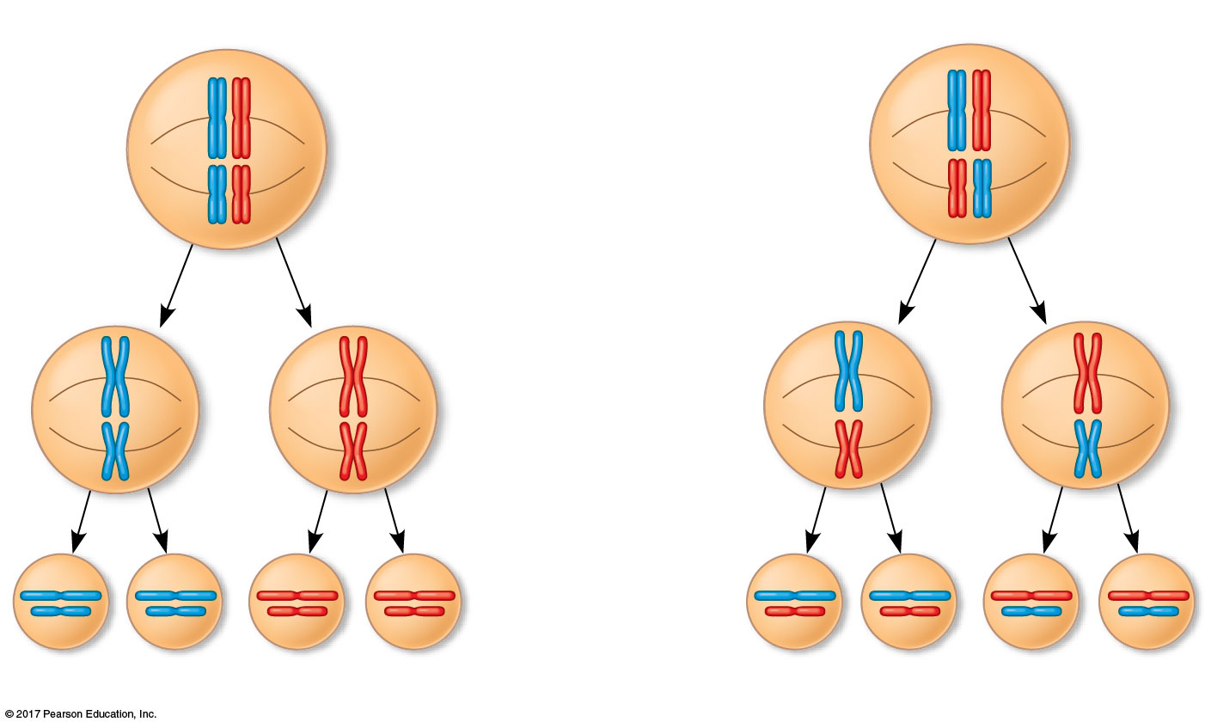
Figure 13.11_3
The independent assortment of homologous chromosomes in meiosis
Possibility 1
Possibility 2
Two equally probable
arrangements of
chromosomes at
metaphase I
Metaphase II
Daughter
cells
Combination 1
Combination 2
Combination 3
Combination 4
Notes:
Figure 13.11_3 The independent assortment of homologous chromosomes in meiosis (step 3)

Slide 57
Crossing Over
Crossing over produces recombinant chromosomes重組型染色體, which combine DNA inherited from each parent
Crossing over contributes to genetic variation by combining DNA from two parents into a single chromosome
In humans, an average of one to three crossover events occurs per chromosome

Slide 58
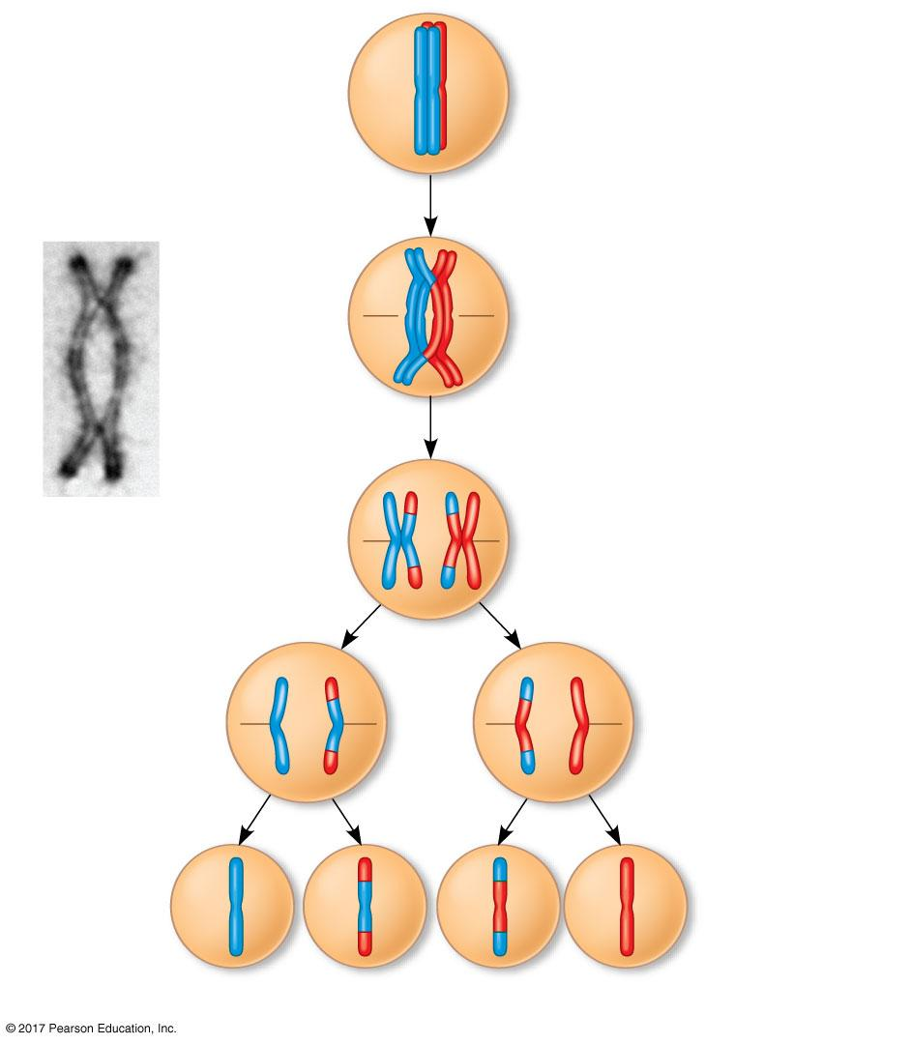
Figure 13.12_4
Prophase I
of meiosis
Nonsister chromatids
held together
during synapsis
Pair of
homologs
1
Synapsis and
crossing over
Chiasma
2
Movement to
the metaphase I
plate
Centromere
TEM
3
Breakdown of
proteins holding
sister chromatid
arms together
Anaphase I
Anaphase II
The results of crossing over during meiosis
Daughter
cells
Recombinant chromosomes
Notes:
Figure 13.12_4 The results of crossing over during meiosis (step 4)

Slide 59
Random Fertilization
Random fertilization adds to genetic variation because any sperm can fuse with any ovum (unfertilized egg)
The fusion of two gametes (each with 8.4 million possible chromosome combinations from independent assortment) produces a zygote with any of about 70 trillion diploid combinations

Slide 60
Crossing over adds even more variation
Each zygote has a unique genetic identity

Slide 61
The Evolutionary Significance of Genetic Variation Within Populations
Natural selection results in the accumulation of genetic variations favored by the environment
Sexual reproduction contributes to the genetic variation in a population, which originates from mutations
Animals that always reproduce asexually are quite rare
Organisms like the bdelloid rotifer increase their genetic diversity through incorporation of foreign DNA from the environment

Slide 62
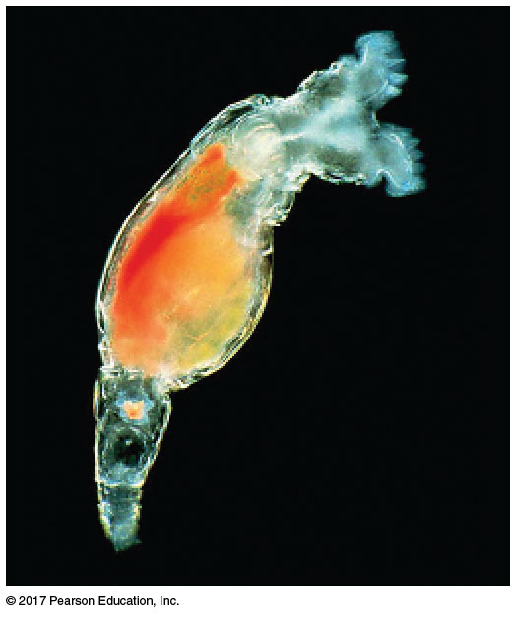
Figure 13.13
A bdelloid rotifer, an animal that reproduces only asexually
200 µm
Notes:
Figure 13.13 A bdelloid rotifer, an animal that reproduces only asexually

